Slide 1






The Bayes Theorem
Introduction and Derivation
Agha Ali Raza
CS535/EE514 – Machine Learning

Slide 2
References
Most of this material is from:
Speech and Language Processing: An Introduction to Natural Language Processing, Computational Linguistics, and Speech Recognition, by Daniel Jurafsky, James H. Martin; Published by Pearson Prentice Hall, 2008, ISBN 0131873210, 9780131873216
Computational Linguistics, Slides, Dr. Sarmad Hussain, CLE
Speech and Language Processing, 3ed, by Daniel Jurafsky, James H. Martin https://web.stanford.edu/~jurafsky/slp3/
Statquest by Josh Starmer, https://statquest.org/video-index/
3Blue1Brown, https://www.youtube.com/channel/UCYO_jab_esuFRV4b17AJtAw
Better Explained by Kalid Azad, https://betterexplained.com/
https://www.autodraw.com/ (for some of the illustrations)

Slide 3
Revision of Probability and
Introduction to Bayes Theorem

Slide 4
Probability
Frequentist Approach:
Frequentist statistics emphasizes the frequency or proportion of times an event occurs in repeated trials.
Probability Interpretation: In frequentist statistics, probability is interpreted as the long-run frequency of occurrence of an event.
Bayesian Approach:
Bayesian statistics focuses on updating beliefs about parameters or hypotheses based on observed data.
Probability Interpretation: In Bayesian statistics, probability is interpreted as a degree of belief or uncertainty about an event or parameter.

Slide 5













Probability
Fair coin toss:
Probability of heads: ½ ← All possible outcomes in the current universe
Probability of tails: ½
Fair dice roll
Probability of getting a 6: 1/6 ← All possible outcomes in the current universe

Slide 6
Joint Probability
Suppose we throw a white and black die simultaneously. What is the probability that the outcomes would sum to 3?
(1,2) and (2,1) are the only two out of 36 possibilities that sum to 3.
So: P(sums to 3) =
2
36

Slide 7

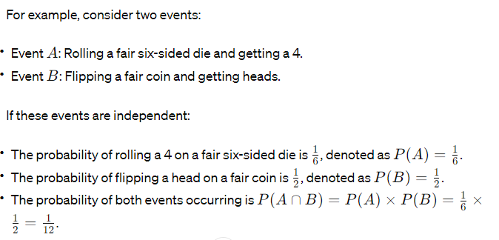
Independent Event
Two events are considered independent if the occurrence of one event does not affect the probability of the other event occurring.

Slide 8
Dependent Event
In probability theory, events are considered dependent if the occurrence (or non-occurrence) of one event affects the probability of another event occurring. In other words, the outcome of one event provides information about the outcome of the other event.

Slide 9
Conditional Probability
Now let us suppose we have already thrown the black dice and get a 2. What is the probability of “sums to 3” given this event:
Only one possibility out of 6 possible outcomes remain
So: P(sums to 3|already a 2 on black dice) = 1/6 (conditional probability)

Slide 10
From Probability to Bayes Theorem
(https://oscarbonilla.com/2009/05/visualizing-bayes-theorem/)
A Universe with all the possible outcomes
Interested in some subset of them (some event)
Assume, we are studying cancer:
We observe people and see whether they have cancer or not.
If we take as our Universe all people participating in our study, then there are two possible outcomes for any particular individual: either they have cancer or they do not have cancer
We can then split our universe in two events:
the event “people with cancer” (designated as A),
the event “people with no cancer” (or ¬A)

Slide 11
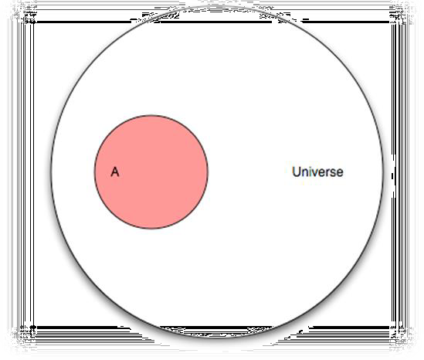
An Event
(https://oscarbonilla.com/2009/05/visualizing-bayes-theorem/)
So what is the probability that a randomly chosen person has cancer?
The number of elements in A divided by the number of elements of U (the Universe).
We denote the number of elements of A as |A| (the cardinality of A).
And define the probability of A, P(A), as
P(A) =
|𝐴|
|𝑈|
Since A can have at most the same number of elements as U, the probability P(A) can be at most 1

Slide 12
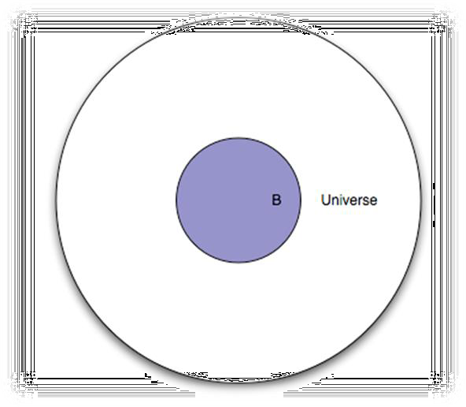
Another Event
(https://oscarbonilla.com/2009/05/visualizing-bayes-theorem/)
Let’s say there is a new screening test that is supposed to measure something
That test will be “positive” for some people, and “negative” for others
If we take the event B to mean “people for whom the test is positive”.
What is the probability that the test will be “positive” for a randomly selected
person?
P(B) =
|𝐵|
|𝑈|

Slide 13
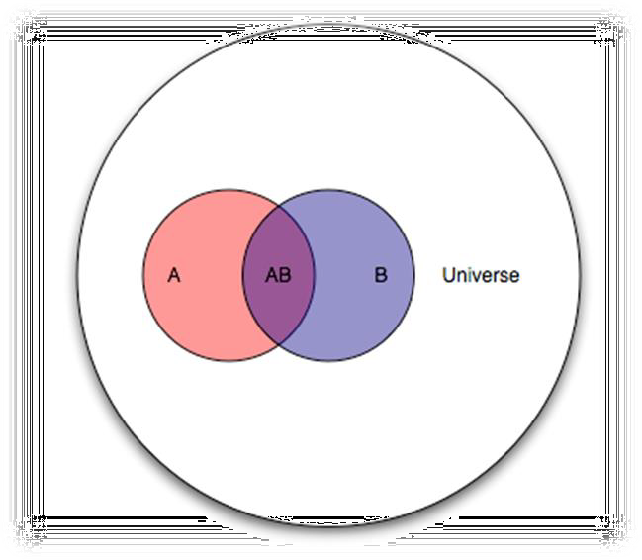
The Two Events Jointly
(https://oscarbonilla.com/2009/05/visualizing-bayes-theorem/)
So far, we have treated the two events in isolation.
What happens if we put them together?
We can compute the probability of both events occurring (AB is a shorthand for A∩B) as:
P(AB) =
|𝐴𝐵|
|𝑈|

Slide 14
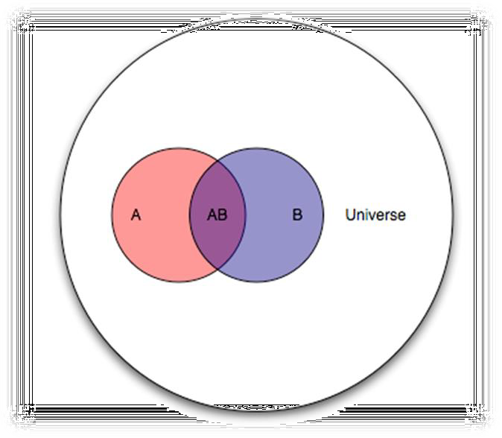
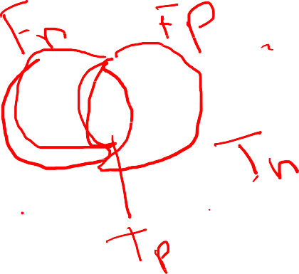
The Two Events Jointly
(https://oscarbonilla.com/2009/05/visualizing-bayes-theorem/)
We are dealing with:
an entire Universe (all people),
the event A (people with cancer),
the event B (people for whom the test is positive)
There is also an overlap, the event AB:
“people with cancer and with a positive test result”.
There is also the event B−AB:
“people with a positive test result and without cancer”
And the event A−AB:
“people with cancer and with a negative test result”.

Slide 15
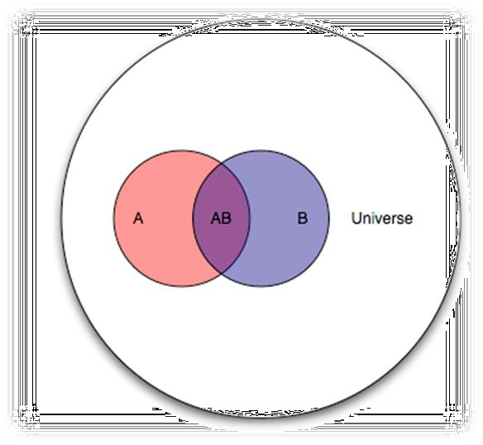

Conditional Probability
(https://oscarbonilla.com/2009/05/visualizing-bayes-theorem/)
“Given that the test is positive for a randomly selected individual, what is the probability that said individual has cancer?”
In terms of our Venn diagram:
“Given that we are in region B, what is the probability that we are in region AB?”
or stated differently:
“If we make region B our new Universe, what is the probability of A?”.
The notation for this is P(A|B) (the probability of A given B
P(A|B)=
|𝐴𝐵|
|𝐵|

Slide 16
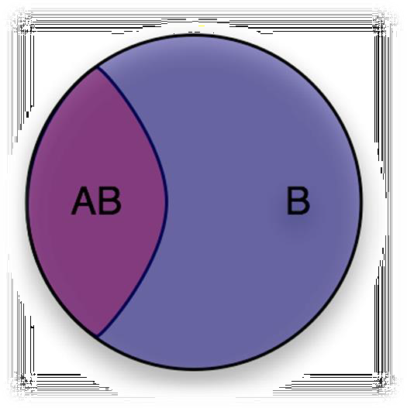
Conditional Probability
(https://oscarbonilla.com/2009/05/visualizing-bayes-theorem/)
Let us convert the counts to probabilities
Dividing both the numerator and the denominator by |U|, we get:
|𝐴𝐵|
P(A|B)=
|𝑈|
|𝐵|
𝑃(𝐴𝐵)
= (Eq-I)
𝑃(𝐵)
|𝑈|
What we’ve effectively done is change the Universe from U (all people), to B (people for whom the test is positive), but we are still dealing with probabilities defined in U.

Slide 17


The Bayes Theorem
(https://oscarbonilla.com/2009/05/visualizing-bayes-theorem/)
Now let’s ask the converse question:
– “given that a randomly selected individual has cancer (event A), what is the probability that the test is positive for that individual (event AB)?”.
It’s easy to see that it is:
P(B|A) =
𝑃(𝐴𝐵)
(Eq-II)
𝑃(𝐴)
Now we have everything we need to derive Bayes' theorem, putting equations I and II together, we get
P(A|B)P(B) = P(B|A)P(A)
which is to say P(AB) is the same whether you’re looking at it from the point of
view of A or B, and finally
𝑃 𝐵 𝐴 𝑃(𝐴)
𝑃(𝐴|𝐵) =
𝑃(𝐵)

Slide 18
The Bayes Theorem
𝑃 𝐵 𝐴 𝑃(𝐴)
𝑃(𝐵)
𝑃(𝐴|𝐵) =

Slide 19




Bayes: Example 1
(Julia Galef: https://www.youtube.com/watch?v=BrK7X_XlGB8)
You walk into a university that has Mathematics PhD and MBA students
You run into a student who is clearly very shy
Is he more likely to be a Mathematics PhD or an MBA?
Mathematics PhD?
Hidden prior based on our belief about the state of our world: There are always way more MBAs than Maths PhDs!

Slide 20
Bayes: Example 1
(Julia Galef: https://www.youtube.com/watch?v=BrK7X_XlGB8)
Assume a population of 1,100 students
100 are Math PhD, 1,000 are MBA
75% of Math (75) are shy
15% of Business (150) are shy
Chances of shy student from Maths
P(Math|Shy) =
𝑐𝑜𝑢𝑛𝑡(𝑆ℎ𝑦 ∩ 𝑀𝑎𝑡ℎ𝑠)
𝑐𝑜𝑢𝑛𝑡(𝑆ℎ𝑦)
=
75
= 33.33%
75+150
Note: We can easily convert the counts to probabilities by dividing the numerator and denominator by |U| = 1,100.

Slide 21

Bayes: Example 1 (directly using the Bayes Theorem)
(Julia Galef: https://www.youtube.com/watch?v=BrK7X_XlGB8)
You walk into a university with Mathematics PhD students and MBA students
You run into a student who is clearly very shy
Is he more likely to be a Mathematics PhD or an MBA?
𝑃 𝑆ℎ𝑦 𝑀𝑎𝑡ℎ 𝑃(𝑀𝑎𝑡ℎ)
𝑃 𝑀𝑎𝑡ℎ 𝑆ℎ𝑦 =
𝑃(𝑆ℎ𝑦)
- 𝑃 𝑀𝑎𝑡ℎ =
𝐶𝑜𝑢𝑛𝑡(𝑀𝑎𝑡ℎ)
=
100
= 0.0909
σ_{𝑠 ∈ 𝑠𝑢𝑏𝑗𝑒𝑐𝑡𝑠} 𝐶𝑜𝑢𝑛𝑡(𝑠𝑡𝑢𝑑𝑒𝑛𝑡𝑠 𝑖𝑛 𝑠)
1,100
=
𝐶𝑜𝑢𝑛𝑡(𝑆ℎ𝑦 ∩ 𝑀𝑎𝑡ℎ𝑠) ₌ 75
(75+100) _{= 0.2045}
- 𝑃 𝑆ℎ𝑦 =
𝐶𝑜𝑢𝑛𝑡(𝑆ℎ𝑦)
σ_{𝑠 ∈𝑠𝑢𝑏𝑗𝑒𝑐𝑡𝑠} 𝐶𝑜𝑢𝑛𝑡(𝑠𝑡𝑢𝑑𝑒𝑛𝑡𝑠 𝑖𝑛 𝑠)
1,100
- 𝑃 𝑆ℎ𝑦 𝑀𝑎𝑡ℎ𝑠 =
= 0.75
𝐶𝑜𝑢𝑛𝑡(𝑀𝑎𝑡ℎ𝑠)
100
Plugging in we get:
𝑃 𝑀𝑎𝑡ℎ𝑠 𝑆ℎ𝑦 =
0.75 ∗ 0.0909
= 𝟎. 𝟑𝟑𝟑𝟑
0.2045

Slide 22

The Bayes Theorem
Posterior
Likelihood
Prior
𝑃 𝐷 ℎ . 𝑃(ℎ)
𝑃 ℎ 𝐷 =
𝑃(𝐷)
Evidence or Predictive Probability
Bayes theorem allows us to update our Prior P(h) to the posterior P(h|D) using the data
Prior is our belief about the world, without looking at the data
The likelihood is the probability of observing this particular D if a particular h
were true e.g.
the probability of a seeing a particular email assuming it’s class was SPAM
The probability of seeing this student assuming the class was Maths PhD
′
𝑃 𝐷 = σ_{ℎ}′ 𝑃 𝐷 ℎ 𝑃(ℎ′) – The evidence is the probability of observing this data, D, regardless of the hypothesis (i.e. summed over all hypotheses)
The Bayes Theorem is a belief updating machine that relies a lot on the prior – hence different priors lead to different posteriors

Slide 23
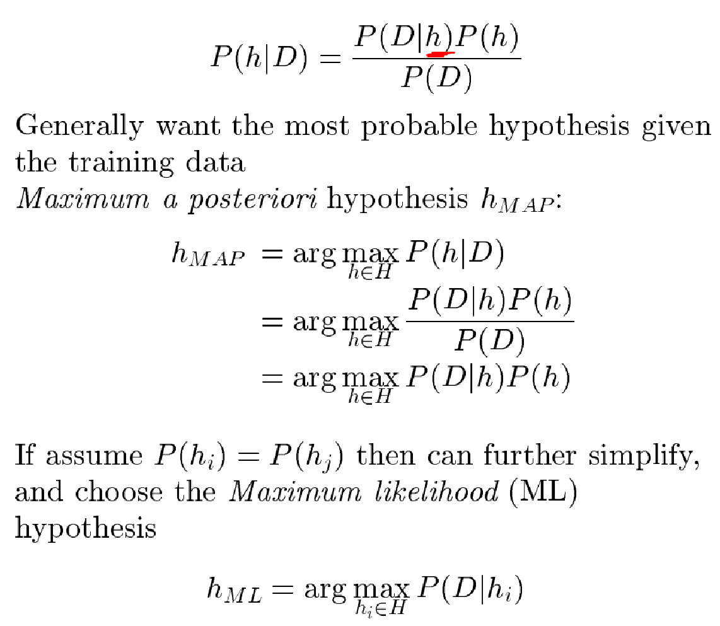
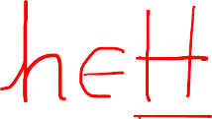


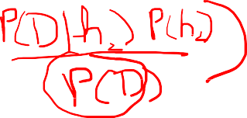

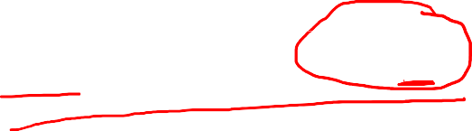
MAP Hypothesis and Classification

Slide 24
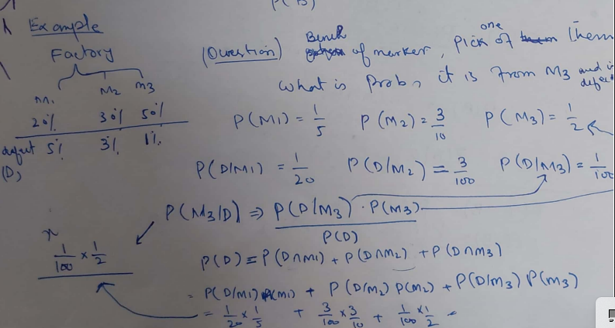

Slide 25
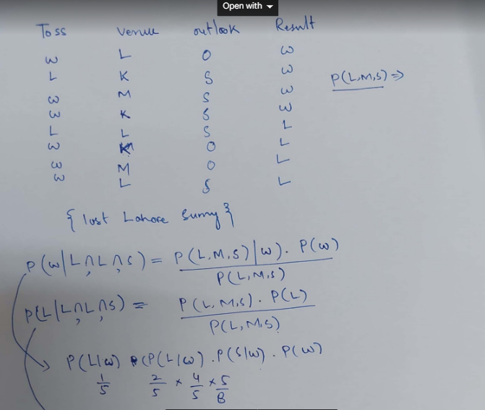

Slide 26
Bayes: Extension of Example 1
(Julia Galef: https://www.youtube.com/watch?v=BrK7X_XlGB8)
Now lets assume there are several subjects and students of various subjects vary on the graph
of shyness
In a population of 600
100 Mathematicians and 75% of them are shy
200 Business majors and 15% of them are shy
300 CS majors and 50% of them are shy
Now given that a student is shy, which is the most likely subject?
₌ P(Shy|Maths) . P(Maths)
P Maths|Shy
P(Shy)
P Business|Shy
₌ P(Shy|Business) . P(Business)
P(Shy)
P CS|Shy
₌ P(Shy|CS) . P(CS)
P(Shy)
And we just pick the hypothesis (subject) with the highest posterior!
P(Shy|Subject) . P(Subject)
𝑆𝑢𝑏𝑗𝑒𝑐𝑡
𝑀𝐴𝑃
= 𝑎𝑟𝑔𝑚𝑎𝑥
𝑆𝑢𝑏𝑗𝑒𝑐𝑡
P(Shy)
Notice that P(Shy) is common in the denominator and does not influence the argmax
𝑆𝑢𝑏𝑗𝑒𝑐𝑡_{𝑀𝐴𝑃} = 𝑎𝑟𝑔𝑚𝑎𝑥_{𝑆𝑢𝑏𝑗𝑒𝑐𝑡} P(Shy|Subject) . P(Subject)

Slide 27
Bayes: Extension of Example 1
(Julia Galef: https://www.youtube.com/watch?v=BrK7X_XlGB8)
𝑆𝑢𝑏𝑗𝑒𝑐𝑡_{𝑀𝐴𝑃} = 𝑎𝑟𝑔𝑚𝑎𝑥_{𝑆𝑢𝑏𝑗𝑒𝑐𝑡} P(Shy|Subject) . P(Subject)
P(Maths|Shy) = 0.75 * 100/600 ➔ 0.125
P(Business|Shy) = 0.15 * 200/600 ➔ 0.05
P(CS|Shy) = 0.50 * 300/600 ➔ 0.25
Therefore, the student is most likely a CS major!

Slide 28
Bayes: Example 2
(https://oscarbonilla.com/2009/05/visualizing-bayes-theorem/)
1% of women at age forty who participate in routine screening have breast cancer. 80% of women with breast cancer will get positive mammograms. 9.6% of women without breast cancer will also get positive mammograms.
A woman in this age group had a positive mammography in a routine screening. What is the probability that she actually has breast cancer?

Slide 29
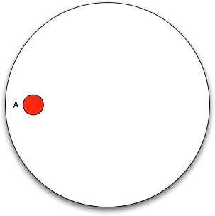
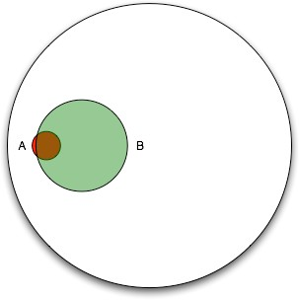

Bayes: Example 2
(https://oscarbonilla.com/2009/05/visualizing-bayes-theorem/)
The women with cancer, A:
The women with positive mammograms, B:
If we restrict our universe to B , only a small percentage actually have cancer.

Slide 30









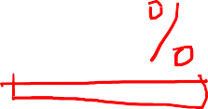

Bayes: Example 2 – Using counts
(https://oscarbonilla.com/2009/05/visualizing-bayes-theorem/)
Assume we have a population of 1,000 women
1% of them (10 women) have cancer. Of these, 80% (8 women) also test positive
990 women do not have cancer. Of these, 9.6% (95 women) test positive
Of the 103 (8+95) women that test positive, only 8 have cancer.
Therefore, probability of cancer given a positive result:
|𝑐𝑎𝑛𝑐𝑒𝑟 ∩ +| 8
𝑃 𝑐𝑎𝑛𝑐𝑒𝑟 + =
= = 0.076%
| + | 103

Slide 31











Bayes: Example 2 – Using h_{MAP}
(https://oscarbonilla.com/2009/05/visualizing-bayes-theorem/)
We can also do the same using MAP hypothesis:
𝑷 𝒄𝒂𝒏𝒄𝒆𝒓 = 𝟎. 𝟎𝟏
𝑷 + 𝒄𝒂𝒏𝒄𝒆𝒓 = 𝟎. 𝟖
𝑷 + ¬𝒄𝒂𝒏𝒄𝒆𝒓 = 𝟎. 𝟎𝟗𝟔
𝑷(¬𝒄𝒂𝒏𝒄𝒆𝒓) = 𝟎. 𝟗𝟗
𝑷(−|𝒄𝒂𝒏𝒄𝒆𝒓) = 𝟎. 𝟐
𝑷(−|¬𝒄𝒂𝒏𝒄𝒆𝒓) = 𝟎. 𝟗𝟎𝟒
𝑷(𝒄𝒂𝒏𝒄𝒆𝒓|+) = 𝑷(+|𝒄𝒂𝒏𝒄𝒆𝒓). 𝑷(𝒄𝒂𝒏𝒄𝒆𝒓) = (0.8) (0.01) = 0.008
𝑷(¬𝒄𝒂𝒏𝒄𝒆𝒓|+) = 𝑷(+|¬𝒄𝒂𝒏𝒄𝒆𝒓). 𝑷(¬𝒄𝒂𝒏𝒄𝒆𝒓) = (0.096) (0.99) = 0.095
Therefore, ℎ_{𝑀𝐴𝑃} = ¬𝑐𝑎𝑛𝑐𝑒𝑟.
We can also retrieve the actual 𝑷(𝒄𝒂𝒏𝒄𝒆𝒓|+) by normalizing using 𝑃(+).
𝑷 + 𝒄𝒂𝒏𝒄𝒆𝒓 . 𝑷 𝒄𝒂𝒏𝒄𝒆𝒓
𝑷 𝒄𝒂𝒏𝒄𝒆𝒓 + =
𝑷 +
𝑷 + 𝒄𝒂𝒏𝒄𝒆𝒓 . 𝑷 𝒄𝒂𝒏𝒄𝒆𝒓
=
𝑷 + 𝒄𝒂𝒏𝒄𝒆𝒓 . 𝑷 𝒄𝒂𝒏𝒄𝒆𝒓 + 𝑷 + ¬𝒄𝒂𝒏𝒄𝒆𝒓 . 𝑷 ¬𝒄𝒂𝒏𝒄𝒆𝒓
=
0.008
= 𝟎. 𝟎𝟕𝟔
0.008+0.095
Although H_{MAP} is ¬𝑐𝑎𝑛𝑐𝑒𝑟, Bayes theorem has updated our belief about P(cancer) from 0.01 to
0.076 using data, i.e. the positive text result.

Slide 32

Bayes: Example 3
(https://arbital.com/p/bayes_frequency_diagram/?l=55z&pathId=6356)
Suppose you are a nurse screening a set of students for a sickness called Diseasitis. You know, from past population studies, that around 20% of the students will have Diseasitis at this time of year.
You are testing for Diseasitis using a color-changing tongue depressor, which usually turns black if the student has Diseasitis. Among patients with Diseasitis, 90% turn the tongue depressor black. However, the tongue depressor is not perfect, and also turns black 30% of the time for healthy students.
One of your students comes into the office, takes the test, and turns the tongue depressor black. What is the probability that they have Diseasitis?

Slide 33


Bayes: Example 3 – Using h_{MAP}
(https://arbital.com/p/bayes_frequency_diagram/?l=55z&pathId=6356)
We can also do the same using MAP hypothesis:
𝑷 𝒅𝒊𝒔 = 𝟎. 𝟐
𝑷 + 𝒅𝒊𝒔 = 𝟎. 𝟗
𝑷 + ¬𝒅𝒊𝒔 = 𝟎. 𝟑
𝑷(¬𝒅𝒊𝒔) = 𝟎. 𝟖
𝑷(−|𝒅𝒊𝒔) = 𝟎. 𝟏
𝑷(−|¬𝒅𝒊𝒔) = 𝟎. 𝟕
𝑷(𝒅𝒊𝒔|+) = 𝑷(+|𝒅𝒊𝒔). 𝑷(𝒅𝒊𝒔) = (0.9) (0.2) = 0.18
𝑷(¬𝒅𝒊𝒔|+) = 𝑷(+|¬𝒅𝒊𝒔). 𝑷(¬𝒅𝒊𝒔) = (0.3) (0.8) = 0.24
Therefore, ℎ_{𝑀𝐴𝑃} = ¬𝑑𝑖𝑠.
We can also retrieve the actual 𝑷(𝒅𝒊𝒔|+) by normalizing using 𝑃(+).
𝑷 + 𝒅𝒊𝒔 . 𝑷 𝒅𝒊𝒔
𝑷 𝒅𝒊𝒔 + =
𝑷 +
𝑷 + 𝒅𝒊𝒔 . 𝑷 𝒅𝒊𝒔
=
𝑷 + 𝒅𝒊𝒔 . 𝑷 𝒅𝒊𝒔 + 𝑷 + ¬𝒅𝒊𝒔 . 𝑷 ¬𝒅𝒊𝒔
=
0.18
= 0.428
0.18+0.24
Although H_{MAP} is ¬𝑑𝑖𝑠, Bayes theorem has updated our belief about P(dis) from 0.2 to 0.428 using data, i.e. the positive test result.

Slide 34


Generative and Discriminative Classifiers
(Ref: SLP3)
Two different frameworks for building Machine Learning models
Discriminative e.g. Logistic regression
Generative e.g. (Naïve) Bayes
Suppose we are trying to distinguish dog images from cat images:
A generative model would:
Learn what dogs and cats look like
Create ‘generators’ for cat and dog images
These generators can draw dogs and cats
Given a test image, the system asks each generator whether it better fits (is less surprised by) the image, and chooses that generator as its label
A discriminative model would:
Learn to distinguish the classes – often without learning much about them
Give higher weights to more discriminating (tell-tale) features
E.g. all the dogs in the training data are wearing collars and the cats are not.
If this one feature neatly separates the classes, the model is satisfied
o All that this model knows about cats is that they do not wear collars

Slide 35











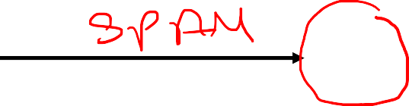














Generative and Discriminative Classifiers

Slide 36
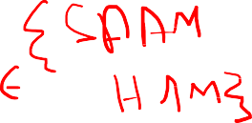

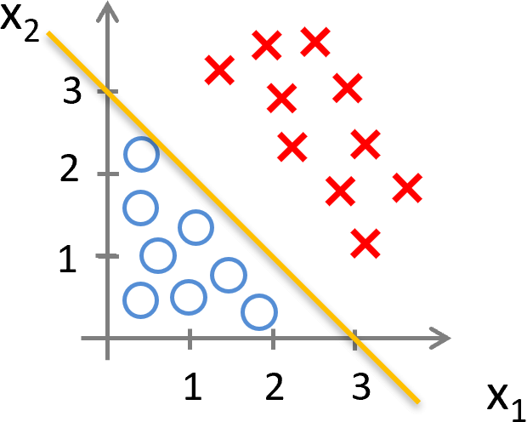
The Discriminative Approach
For the test email, try to directly estimate: 𝑃 𝐶𝑙𝑎𝑠𝑠 𝐸𝑚𝑎𝑖𝑙
The Email would be represented by the features 𝑥₁, 𝑥₂, 𝑥₃, … , 𝑥_{𝑛}
Using the training data, for each feature 𝑥_{𝑖}, try to learn a weight 𝜃_{𝑖}:
Features that are better suited to distinguish between the classes would get a higher weight
Features whose presence/absence correlates with a particular class get a positive/negative weight
e.g. words like “singles”, “$”, “double”, “money”, “best”, “cheap”, “FREE”
etc. may signal a SPAM email.
𝑃 𝐶𝑙𝑎𝑠𝑠 𝐸𝑚𝑎𝑖𝑙 = 𝑃 𝐶𝑙𝑎𝑠𝑠 𝑥₁, 𝑥₂, 𝑥₃, … , 𝑥_{𝑛}
ℎ_{𝜃} 𝑥 = 𝜃₀ + 𝜃₁𝑥₁ + 𝜃₂𝑥₂ + 𝜃₃𝑥₃ + ⋯ + 𝜃_{𝑛}𝑥_{𝑛}
𝑃(𝐶𝑙𝑎𝑠𝑠|𝑥₁, 𝑥₂, 𝑥₃, … , 𝑥_{𝑛}) = 𝜎 ℎ_{𝜃} 𝑥 =
1
_{1+ⅇ}−ℎ_{𝜃} 𝑥
𝑃𝑟𝑒𝑑𝑖𝑐𝑡: "𝑆𝑃𝐴𝑀" 𝑖𝑓 𝜎 ℎ_{𝜃} 𝑥
•
≥ 0.5
𝑃𝑟𝑒𝑑𝑖𝑐𝑡: "𝑁𝑜𝑡 𝑆𝑃𝐴𝑀" 𝑖𝑓 𝜎 ℎ_{𝜃} 𝑥 < 0.5

Slide 37







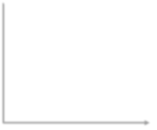

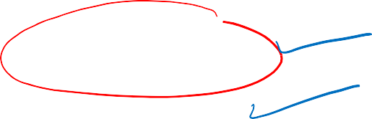



The Generative Approach
𝑷(𝑬𝒎𝒂𝒊𝒍│𝑪𝒍𝒂𝒔𝒔). 𝑷(𝑪𝒍𝒂𝒔𝒔)
𝑪𝒍𝒂𝒔𝒔_{𝑴𝑨𝑷} = 𝒂𝒓𝒈𝒎𝒂𝒙_{𝑪𝒍𝒂𝒔𝒔}𝑷 𝑪𝒍𝒂𝒔𝒔 𝑬𝒎𝒂𝒊𝒍 = 𝒂𝒓𝒈𝒎𝒂𝒙_{𝑪𝒍𝒂𝒔𝒔}
𝑷(𝑬𝒎𝒂𝒊𝒍)
𝑷(𝒙_{𝟏}, 𝒙_{𝟐}, 𝒙_{𝟑}, … , 𝒙_{𝒏}│𝑪𝒍𝒂𝒔𝒔). 𝑷(𝑪𝒍𝒂𝒔𝒔)
= 𝒂𝒓𝒈𝒎𝒂𝒙
𝑪𝒍𝒂𝒔𝒔
𝑷 𝑪𝒍𝒂𝒔𝒔 𝒙 , 𝒙 , 𝒙 , … , 𝒙
= 𝒂𝒓𝒈𝒎𝒂𝒙
𝟏 𝟐 𝟑
𝒏
𝑪𝒍𝒂𝒔𝒔
𝑷(𝒙_{𝟏}, 𝒙_{𝟐}, 𝒙_{𝟑}, … , 𝒙_{𝒏})
= 𝒂𝒓𝒈𝒎𝒂𝒙_{𝑪𝒍𝒂𝒔𝒔} 𝑷(𝒙_{𝟏}, 𝒙_{𝟐}, 𝒙_{𝟑}, … , 𝒙_{𝒏}│𝑪𝒍𝒂𝒔𝒔). 𝑷(𝑪𝒍𝒂𝒔𝒔)
SPAM
Generator
Non-SPAM
Generator
How likely are you to generate this data
<𝑥₁, 𝑥₂, 𝑥₃, … , 𝑥_{𝑛}>?
How likely are you to generate this data
<𝑥₁, 𝑥₂, 𝑥₃, … , 𝑥_{𝑛}>?
P(𝑥₁, 𝑥₂, 𝑥₃, … , 𝑥_{𝑛} |SPAM).P(SPAM)
max(SPAM, Non-SPAM)
P(𝑥₁, 𝑥₂, 𝑥₃, … , 𝑥_{𝑛} |Non-SPAM).P(Non-SPAM)
^{ℎ}𝑀𝐴𝑃

Slide 38

The SPAM vs. Not-SPAM Problem

Slide 39
Classification using the Bayes Theorem
𝑃(𝐷|ℎ) 𝑃(ℎ)
𝑃(ℎ|𝐷) =
𝑃(𝐷)
𝑃(𝐸𝑚𝑎𝑖𝑙│𝐶𝑙𝑎𝑠𝑠). 𝑃(𝐶𝑙𝑎𝑠𝑠)
𝐶𝑙𝑎𝑠𝑠_{𝑀𝐴𝑃} = 𝑎𝑟𝑔𝑚𝑎𝑥_{𝐶𝑙𝑎𝑠𝑠} 𝑃 𝐶𝑙𝑎𝑠𝑠 𝐸𝑚𝑎𝑖𝑙
= 𝑎𝑟𝑔𝑚𝑎𝑥_{𝐶𝑙𝑎𝑠𝑠}
𝑃(𝐸𝑚𝑎𝑖𝑙)
𝑤ℎ𝑒𝑟𝑒 𝐶𝑙𝑎𝑠𝑠 ∈ {𝑆𝑃𝐴𝑀, 𝑁𝑜𝑡 𝑆𝑃𝐴𝑀}
𝑃(𝑥₁, 𝑥₂, 𝑥₃, … , 𝑥_{𝑛}│𝐶𝑙𝑎𝑠𝑠). 𝑃(𝐶𝑙𝑎𝑠𝑠)
𝑃 𝐶𝑙𝑎𝑠𝑠 𝑥₁, 𝑥₂, 𝑥₃, … , 𝑥_{𝑛} = 𝐴𝑟𝑔𝑚𝑎𝑥_{𝐶𝑙𝑎𝑠𝑠}
𝑃(𝑥₁, 𝑥₂, 𝑥₃, … , 𝑥_{𝑛})
𝑃 𝐶𝑙𝑎𝑠𝑠 𝑥₁, 𝑥₂, 𝑥₃, … , 𝑥_{𝑛}
= 𝐴𝑟𝑔𝑚𝑎𝑥_{𝐶𝑙𝑎𝑠𝑠} 𝑃(𝑥₁, 𝑥₂, 𝑥₃, … , 𝑥_{𝑛}│𝐶𝑙𝑎𝑠𝑠). 𝑃(𝐶𝑙𝑎𝑠𝑠)

Slide 40
What’s the probability that a randomly selected email would be SPAM?
𝑆𝑃𝐴𝑀 = 𝑆 = 3, 𝑁𝑜𝑡 𝑆𝑃𝐴𝑀 = |𝑁| = 5
3
𝑆 + |𝑁| 8
𝑆
𝑃 𝑆 =
=
5
𝑆 + |𝑁| 8
𝑁
𝑃 𝑁 =
=
So, this is our prior about the probability of getting a SPAM email before even looking at a particular email.

Slide 41












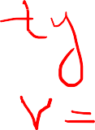










Now, lets start counting!
𝑷 𝑺
₌ 𝟑
𝑷 𝑵
₌ 𝟓
𝟖
𝟖
𝑷 𝒘𝒊𝒏 𝑺 =
𝟕
𝟏𝟕
𝑷 𝒉𝒆𝒍𝒍𝒐 𝑵 =
𝟕
𝟏𝟖
𝟓
𝑷 𝒑𝒓𝒊𝒛𝒆 𝑺 =
𝟏𝟕
𝟓
𝑷 𝒇𝒓𝒊𝒆𝒏𝒅 𝑵 =
𝟏𝟖
𝟑
𝑷 𝒇𝒓𝒊𝒆𝒏𝒅 𝑺 =
𝟏𝟕
𝑷 𝒘𝒐𝒓𝒌 𝑵
𝑷 𝒑𝒓𝒊𝒛𝒆 𝑵 =
𝟏
𝟏𝟖
hello friend prize work
𝟑
=
𝟏𝟖
𝟐
𝑷 𝒘𝒊𝒏 𝑵 =
𝟐
𝑷 𝒉𝒆𝒍𝒍𝒐 𝑺 =
𝟏𝟕
𝟏𝟖
𝑷 𝒘𝒐𝒓𝒌 𝑺 = 𝟎
prize work
hello
friend
win
win
“Hello friend”
𝑷 𝑵 𝒉𝒆𝒍𝒍𝒐 𝒇𝒓𝒊𝒆𝒏𝒅
𝑷 𝑺 𝒉𝒆𝒍𝒍𝒐 𝒇𝒓𝒊𝒆𝒏𝒅
= 𝑷 𝑺 ∗ 𝑷 𝒉𝒆𝒍𝒍𝒐 𝑺 ∗ 𝑷 𝒇𝒓𝒊𝒆𝒏𝒅 𝑺
= 𝑷 𝑵 ∗ 𝑷 𝒉𝒆𝒍𝒍𝒐 𝑵 ∗ 𝑷 𝒇𝒓𝒊𝒆𝒏𝒅 𝑵
𝟓
𝟑 𝟐 𝟑
𝟓 𝟕
= ∗
∗ = 𝟎. 𝟎𝟎𝟕𝟕𝟖
= ∗
∗ = 𝟎. 𝟎𝟔𝟕𝟓
𝟖 𝟏𝟕 𝟏𝟕
𝟖 𝟏𝟖 𝟏𝟖
𝒉_{𝑴𝑨𝑷} = 𝒂𝒓𝒈𝒎𝒂𝒙(𝑷 𝑺|𝒉𝒆𝒍𝒍𝒐 𝒇𝒓𝒊𝒆𝒏𝒅 , 𝑷 𝑵|𝒉𝒆𝒍𝒍𝒐 𝒇𝒓𝒊𝒆𝒏𝒅 )
𝒉_{𝑴𝑨𝑷} = 𝑵𝒐𝒕𝑺𝑷𝑨𝑴

Slide 42
𝑷 𝑺
₌ 𝟑
𝑷 𝑵
₌ 𝟓
𝟖
𝟖
𝑷 𝒘𝒊𝒏 𝑺 =
𝟕
𝟏𝟕
𝑷 𝒉𝒆𝒍𝒍𝒐 𝑵 =
𝟕
𝟏𝟖
𝟓
𝑷 𝒑𝒓𝒊𝒛𝒆 𝑺 =
𝟏𝟕
𝟓
𝑷 𝒇𝒓𝒊𝒆𝒏𝒅 𝑵 =
𝟏𝟖
𝟑
𝑷 𝒇𝒓𝒊𝒆𝒏𝒅 𝑺 =
𝟏𝟕
𝑷 𝒘𝒐𝒓𝒌 𝑵
𝑷 𝒑𝒓𝒊𝒛𝒆 𝑵 =
𝟏
𝟏𝟖
𝟑
=
𝟏𝟖
𝟐
𝑷 𝒘𝒊𝒏 𝑵 =
𝟐
𝑷 𝒉𝒆𝒍𝒍𝒐 𝑺 =
𝟏𝟕
𝟏𝟖
𝑷 𝒘𝒐𝒓𝒌 𝑺 = 𝟎
prize work
hello
friend
win
hello
friend
prize work
win
“win prize”
𝑷 𝑺 𝒘𝒊𝒏 𝒑𝒓𝒊𝒛𝒆
𝑷 𝑵 𝒘𝒊𝒏 𝒑𝒓𝒊𝒛𝒆
= 𝑷 𝑺 ∗ 𝑷 𝒘𝒊𝒏 𝑺 ∗ 𝑷 𝒑𝒓𝒊𝒛𝒆 𝑺
= 𝑷 𝑵 ∗ 𝑷 𝒘𝒊𝒏 𝑵 ∗ 𝑷 𝒑𝒓𝒊𝒛𝒆 𝑵
𝟏
𝟑 𝟕
𝟓
𝟓 𝟐
= ∗
∗ = 𝟎. 𝟎𝟒𝟓
= ∗
∗ = 𝟎. 𝟎𝟎𝟑𝟖
𝟖 𝟏𝟕 𝟏𝟕
𝟖 𝟏𝟖 𝟏𝟖
𝒉_{𝑴𝑨𝑷} = 𝒂𝒓𝒈𝒎𝒂𝒙(𝑷(𝑺│𝒘𝒊𝒏 𝒑𝒓𝒊𝒛𝒆), 𝑷(𝑵│𝒘𝒊𝒏 𝒑𝒓𝒊𝒛𝒆))
𝒉_{𝑴𝑨𝑷} = 𝑺𝑷𝑨𝑴

Slide 43

𝑷 𝑺
₌ 𝟑
𝑷 𝑵
₌ 𝟓
𝟖
𝟖
𝑷 𝒘𝒊𝒏 𝑺 =
𝟕
𝟏𝟕
𝑷 𝒉𝒆𝒍𝒍𝒐 𝑵 =
𝟕
𝟏𝟖
𝟓
𝑷 𝒑𝒓𝒊𝒛𝒆 𝑺 =
𝟏𝟕
𝟓
𝑷 𝒇𝒓𝒊𝒆𝒏𝒅 𝑵 =
𝟏𝟖
𝟑
𝑷 𝒇𝒓𝒊𝒆𝒏𝒅 𝑺 =
𝟏𝟕
𝑷 𝒘𝒐𝒓𝒌 𝑵
𝑷 𝒑𝒓𝒊𝒛𝒆 𝑵 =
𝟏
𝟏𝟖
hello friend prize work
𝟑
=
𝟏𝟖
𝟐
𝑷 𝒘𝒊𝒏 𝑵 =
𝟐
𝑷 𝒉𝒆𝒍𝒍𝒐 𝑺 =
𝟏𝟕
𝟏𝟖
𝑷 𝒘𝒐𝒓𝒌 𝑺 = 𝟎
prize work
hello
friend
win
win
“win prize win work”
𝑷 𝑵 𝒘𝒊𝒏 𝒑𝒓𝒊𝒛𝒆 𝒘𝒊𝒏 𝒘𝒐𝒓𝒌
= 𝑷 𝑵 ∗ 𝑷 𝒘𝒊𝒏 𝑵 ∗ 𝑷 𝒑𝒓𝒊𝒛𝒆 𝑵 ∗
𝑷 𝒘𝒊𝒏|𝑵 ∗ 𝑷(𝒘𝒐𝒓𝒌|𝑵)
𝑷 𝑺 𝒘𝒊𝒏 𝒑𝒓𝒊𝒛𝒆 𝒘𝒊𝒏 𝒘𝒐𝒓𝒌
= 𝑷 𝑺 ∗ 𝑷 𝒘𝒊𝒏 𝑺 ∗ 𝑷 𝒑𝒓𝒊𝒛𝒆 𝑺 ∗
𝑷 𝒘𝒊𝒏|𝑺 ∗ 𝑷(𝒘𝒐𝒓𝒌|𝑺)
𝟑 𝟕 𝟓 𝟕
𝟓 𝟐 𝟏 𝟐 𝟑
= ∗
∗ ∗ ∗ 𝟎 = 𝟎‼!
= ∗ ∗ ∗ ∗ = 𝟎. 𝟎𝟎𝟎𝟎𝟕
𝟖 𝟏𝟕
𝟏𝟕 𝟏𝟕 𝟖 𝟏𝟖 𝟏𝟖 𝟏𝟖 𝟏𝟖
𝒉_{𝑴𝑨𝑷} = 𝒂𝒓𝒈𝒎𝒂𝒙(𝑷(𝑺│𝒘𝒊𝒏 𝒑𝒓𝒊𝒛𝒆 𝒘𝒊𝒏 𝒘𝒐𝒓𝒌), 𝑷(𝑵│𝒘𝒊𝒏 𝒑𝒓𝒊𝒛𝒆 𝒘𝒊𝒏 𝒘𝒐𝒓𝒌))
𝒉_{𝑴𝑨𝑷} = 𝑵𝒐𝒕𝑺𝑷𝑨𝑴? ? ?

Slide 44
𝑷 𝑺
₌ 𝟑
𝑷 𝑵
₌ 𝟓
𝟖
𝟖
𝑷 𝒘𝒊𝒏 𝑺 =
𝟕
𝟏𝟕
𝑷 𝒉𝒆𝒍𝒍𝒐 𝑵 =
𝟕
𝟏𝟖
𝟓
𝑷 𝒑𝒓𝒊𝒛𝒆 𝑺 =
𝟏𝟕
𝟓
𝑷 𝒇𝒓𝒊𝒆𝒏𝒅 𝑵 =
𝟏𝟖
𝟑
𝑷 𝒇𝒓𝒊𝒆𝒏𝒅 𝑺 =
𝟏𝟕
𝑷 𝒘𝒐𝒓𝒌 𝑵
𝑷 𝒑𝒓𝒊𝒛𝒆 𝑵 =
𝟏
𝟏𝟖
hello friend prize work
𝟑
=
𝟏𝟖
𝟐
𝑷 𝒘𝒊𝒏 𝑵 =
𝟐
𝑷 𝒉𝒆𝒍𝒍𝒐 𝑺 =
𝟏𝟕
𝟏𝟖
𝑷 𝒘𝒐𝒓𝒌 𝑺 = 𝟎
prize work
hello
friend
win
win
“win prize win money”
𝑷 𝑵 𝒘𝒊𝒏 𝒑𝒓𝒊𝒛𝒆 𝒘𝒊𝒏 𝒎𝒐𝒏𝒆𝒚
= 𝑷 𝑵 ∗ 𝑷 𝒘𝒊𝒏 𝑵 ∗ 𝑷 𝒑𝒓𝒊𝒛𝒆 𝑵 ∗
𝑷 𝒘𝒊𝒏|𝑵 ∗ 𝑷(𝒎𝒐𝒏𝒆𝒚|𝑵)
𝑷 𝑺 𝒘𝒊𝒏 𝒑𝒓𝒊𝒛𝒆 𝒘𝒊𝒏 𝒎𝒐𝒏𝒆𝒚
= 𝑷 𝑺 ∗ 𝑷 𝒘𝒊𝒏 𝑺 ∗ 𝑷 𝒑𝒓𝒊𝒛𝒆 𝑺 ∗
𝑷 𝒘𝒊𝒏|𝑺 ∗ 𝑷(𝒎𝒐𝒏𝒆𝒚|𝑺)
𝟑 𝟕 𝟓 𝟕
𝟓 𝟐 𝟏 𝟐
= ∗
∗ ∗ ∗ 𝟎? = 𝟎‼!
= ∗ ∗ ∗
∗ 𝟎? = 𝟎‼!
𝟖 𝟏𝟕 𝟏𝟕 𝟏𝟕
𝟖 𝟏𝟖 𝟏𝟖 𝟏𝟖
𝒉_{𝑴𝑨𝑷} = 𝒂𝒓𝒈𝒎𝒂𝒙 𝑷 𝑺 𝒘𝒊𝒏 𝒑𝒓𝒊𝒛𝒆 𝒘𝒊𝒏 𝒘𝒐𝒓𝒌 , 𝑷 𝑵 𝒘𝒊𝒏 𝒑𝒓𝒊𝒛𝒆 𝒘𝒊𝒏 𝒎𝒐𝒏𝒆𝒚 ?

Slide 45


𝑷 𝑺
₌ 𝟑
𝑷 𝑵
₌ 𝟓
𝟖
𝟖
𝑷 𝒘𝒊𝒏 𝑺 =
𝟕
𝟏𝟕
𝑷 𝒉𝒆𝒍𝒍𝒐 𝑵 =
𝟕
𝟏𝟖
𝟓
𝑷 𝒑𝒓𝒊𝒛𝒆 𝑺 =
𝟏𝟕
𝟓
𝑷 𝒇𝒓𝒊𝒆𝒏𝒅 𝑵 =
𝟏𝟖
𝟑
𝑷 𝒇𝒓𝒊𝒆𝒏𝒅 𝑺 =
𝟏𝟕
𝑷 𝒘𝒐𝒓𝒌 𝑵
𝑷 𝒑𝒓𝒊𝒛𝒆 𝑵 =
𝟏
𝟏𝟖
hello friend prize work
𝟑
=
𝟏𝟖
𝟐
𝑷 𝒘𝒊𝒏 𝑵 =
𝟐
𝑷 𝒉𝒆𝒍𝒍𝒐 𝑺 =
𝟏𝟕
𝟏𝟖
𝑷 𝒘𝒐𝒓𝒌 𝑺 = 𝟎
prize work
hello
friend
win
win
“win prize win money”
𝑷 𝑵 𝒘𝒊𝒏 𝒑𝒓𝒊𝒛𝒆 𝒘𝒊𝒏
𝑷 𝑺 𝒘𝒊𝒏 𝒑𝒓𝒊𝒛𝒆 𝒘𝒊𝒏
= 𝑷 𝑺 ∗ 𝑷 𝒘𝒊𝒏 𝑺 ∗ 𝑷 𝒑𝒓𝒊𝒛𝒆 𝑺 ∗ 𝑷 𝒘𝒊𝒏|𝑺
= 𝑷 𝑵
∗ 𝑷 𝒘𝒊𝒏 𝑵 ∗ 𝑷 𝒑𝒓𝒊𝒛𝒆 𝑵 ∗ 𝑷 𝒘𝒊𝒏|𝑵
𝟏 𝟐
𝟑 𝟕 𝟓 𝟕
𝟓 𝟐
= ∗ ∗ ∗ = 𝟎. 𝟎𝟏𝟖
= ∗
∗ ∗ = 𝟎. 𝟎𝟎𝟎𝟒𝟐
𝟖 𝟏𝟕 𝟏𝟕 𝟏𝟕
𝟖 𝟏𝟖 𝟏𝟖 𝟏𝟖
𝒉_{𝑴𝑨𝑷} = 𝒂𝒓𝒈𝒎𝒂𝒙 𝑷 𝑺 𝒘𝒊𝒏 𝒑𝒓𝒊𝒛𝒆 𝒘𝒊𝒏 𝒘𝒐𝒓𝒌 , 𝑷 𝑵 𝒘𝒊𝒏 𝒑𝒓𝒊𝒛𝒆 𝒘𝒊𝒏
𝒉_{𝑴𝑨𝑷} = 𝑺𝑷𝑨𝑴

Slide 46
Naïve Bayes Intuition
Classification method based on Bayes rule
A simple (naïve) assumption about how the features interact with one another
Relies on a very simple representation of the document
Bag of words

Slide 47

Classification using the Bayes Theorem
𝑃(𝐷|ℎ) 𝑃(ℎ)
𝑃(ℎ|𝐷) =
𝑃(𝐷)
𝑃(𝐸𝑚𝑎𝑖𝑙│𝐶𝑙𝑎𝑠𝑠). 𝑃(𝐶𝑙𝑎𝑠𝑠)
𝐶𝑙𝑎𝑠𝑠_{𝑀𝐴𝑃} = 𝑎𝑟𝑔𝑚𝑎𝑥_{𝐶𝑙𝑎𝑠𝑠}𝑃 𝐶𝑙𝑎𝑠𝑠 𝐸𝑚𝑎𝑖𝑙 = 𝑎𝑟𝑔𝑚𝑎𝑥_{𝐶𝑙𝑎𝑠𝑠}
𝑤ℎ𝑒𝑟𝑒 𝐶𝑙𝑎𝑠𝑠 ∈ {𝑆𝑃𝐴𝑀, 𝑁𝑜𝑡 𝑆𝑃𝐴𝑀}
𝑃(𝐸𝑚𝑎𝑖𝑙)
𝑃(𝑥₁, 𝑥₂, 𝑥₃, … , 𝑥_{𝑛}│𝐶𝑙𝑎𝑠𝑠). 𝑃(𝐶𝑙𝑎𝑠𝑠)
𝑎𝑟𝑔𝑚𝑎𝑥
𝐶𝑙𝑎𝑠𝑠
𝑃 𝐶𝑙𝑎𝑠𝑠 𝑥₁, 𝑥₂, 𝑥₃, … , 𝑥_{𝑛}
= 𝑎𝑟𝑔𝑚𝑎𝑥
𝐶𝑙𝑎𝑠𝑠
𝑃(𝑥₁, 𝑥₂, 𝑥₃, … , 𝑥_{𝑛})
𝐶𝑙𝑎𝑠𝑠_{𝑀𝐴𝑃} = 𝑎𝑟𝑔𝑚𝑎𝑥_{𝐶𝑙𝑎𝑠𝑠} 𝑃(𝑥₁, 𝑥₂, 𝑥₃, … , 𝑥_{𝑛}│𝐶𝑙𝑎𝑠𝑠). 𝑃(𝐶𝑙𝑎𝑠𝑠)

Slide 48











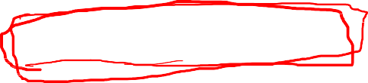





Naïve Assumptions
𝒉_{𝑴𝑨𝑷} = 𝒂𝒓𝒈𝒎𝒂𝒙_{𝑪𝒍𝒂𝒔𝒔} 𝑷 𝒙_{𝟏}, 𝒙_{𝟐}, 𝒙_{𝟑}, … , 𝒙_{𝒏} 𝑪𝒍𝒂𝒔𝒔 . 𝑷 𝑪𝒍𝒂𝒔𝒔
How to calculate 𝑷 𝒙_{𝟏}, 𝒙_{𝟐}, 𝒙_{𝟑}, … , 𝒙_{𝒏} 𝑪𝒍𝒂𝒔𝒔 ?
Hard to compute directly
Every possible set of words and positions
For example, using the chain rule for the given positions and word-features only:
𝑃 𝑑𝑒𝑎𝑟 𝑓𝑟𝑖𝑒𝑛𝑑 𝑐𝑎𝑙𝑙 𝑚𝑒 𝑆 =
𝑃 𝑑𝑒𝑎𝑟 𝑆 . 𝑃 𝑓𝑟𝑖𝑒𝑛𝑑 𝑑𝑒𝑎𝑟 𝑆 . 𝑃 𝑐𝑎𝑙𝑙 𝑑𝑒𝑎𝑟 𝑓𝑟𝑖𝑒𝑛𝑑 𝑆 . 𝑃 𝑚𝑒 𝑑𝑒𝑎𝑟 𝑓𝑟𝑖𝑒𝑛𝑑 𝑐𝑎𝑙𝑙 𝑆
Could only be estimated if a very, very large number of training examples was available.
Naïve Bayes makes two simplifying assumptions

Slide 49









How to calculate the probability of a sentence?
P(W|c) = P(w₁|c) . P(w₂|w₁,c) . P(w₃|w₁w₂ ,c) … P(w_{n}|w₁w₂ ,…,w_{n-1} ,c)
For example:
P(My dear, here we must run as fast as we can, just to stay in place. And if you wish to go anywhere you must run twice as fast as that|c) = P(My|c) . P(dear | My,c) . P(, | My dear,c) . P(here | My dear, ,c) . …
P(that | My dear, here,… as,c)
_{P(My|c) =} |𝑀𝑦∩𝑐| ₌ |𝑀𝑦∩𝑐|
|𝑐| 𝑁
_{P(dear | My,c) =} |𝑀𝑦 𝑑𝑒𝑎𝑟∩𝑐| ₌ |𝑀𝑦 𝑑𝑒𝑎𝑟∩𝑐|
|𝑀𝑦 𝑥∩𝑐| |𝑀𝑦∩𝑐|
P(here | My dear, ,c) = ^{|𝑀𝑦 𝑑𝑒𝑎𝑟, ℎ𝑒𝑟𝑒∩𝑐|}
|𝑀𝑦 𝑑𝑒𝑎𝑟,∩𝑐|
P(that | My dear, here,… as,c) =
𝑐𝑜𝑢𝑛𝑡(𝑀𝑦 𝑑𝑒𝑎𝑟, ℎ𝑒𝑟𝑒,…,𝑎𝑠 𝑡ℎ𝑎𝑡)
𝑐𝑜𝑢𝑛𝑡(𝑀𝑦 𝑑𝑒𝑎𝑟, ℎ𝑒𝑟𝑒,…,𝑎𝑠)
Rare events

Slide 50





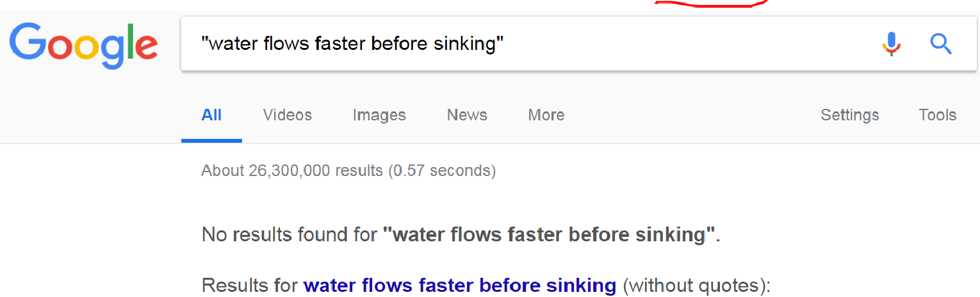

Problem: Language is creative!
Language is creative. Too many possible sentences!
Hard to estimate longer sentences as context may occur very infrequently in text
We may never see enough data for estimating these

Slide 51




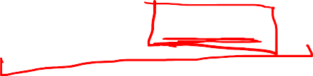
Naïve Bayes Independence Assumptions
Conditional Independence (aka Naïve Bayes assumption): Assume the feature probabilities P(x_{i}|c_{j}) are independent given the class c.
For example, a fruit is an apple if it is red, round, and about 10 cm in diameter.
A naive Bayes classifier considers each of these features to contribute independently to the probability that this fruit is an apple, regardless of any possible correlations between the color, roundness, and diameter features.
Bag of Words assumption: Assume position doesn’t matter
𝑷 𝒙_{𝟏}, 𝒙_{𝟐}, 𝒙_{𝟑}, … , 𝒙_{𝒏} 𝑪𝒍𝒂𝒔𝒔
= 𝑷 𝒙_{𝟏} 𝑪𝒍𝒂𝒔𝒔 . 𝑷 𝒙_{𝟐} 𝒙_{𝟏}, 𝑪𝒍𝒂𝒔𝒔 . 𝑷 𝒙_{𝟑} 𝒙_{𝟏}, 𝒙_{𝟐}, 𝑪𝒍𝒂𝒔𝒔 … 𝑷 𝒙_{𝒏} 𝒙_{𝟏}, 𝒙_{𝟐}, … 𝒙_{𝒏−𝟏}, 𝑪𝒍𝒂𝒔𝒔
≈ 𝑷 𝒙_{𝟏} 𝑪𝒍𝒂𝒔𝒔 . 𝑷 𝒙_{𝟐} 𝑪𝒍𝒂𝒔𝒔 . 𝑷 𝒙_{𝟑} 𝑪𝒍𝒂𝒔𝒔 … 𝑷 𝒙_{𝒏} 𝑪𝒍𝒂𝒔𝒔
𝑷𝒐𝒔𝒊𝒕𝒊𝒐𝒏𝒔 ← 𝑨𝒍𝒍 𝒘𝒐𝒓𝒅 𝒑𝒐𝒔𝒊𝒕𝒊𝒐𝒏𝒔 𝒊𝒏 𝒕𝒉𝒆 𝒅𝒐𝒄𝒖𝒎𝒆𝒏𝒕
𝒄_{𝑵𝑩} = 𝒂𝒓𝒈𝒎𝒂𝒙_{𝒄∈𝑪𝒍𝒂𝒔𝒔}𝑷 𝒄
^{ς}𝒊∈𝑷𝒐𝒔𝒊𝒕𝒊𝒐𝒏𝒔 ^{𝑷(𝒘}𝒊^{|𝒄)}
As this leads to very small numbers, we take a log without impacting the argmax:
𝒄_{𝑵𝑩} = 𝒂𝒓𝒈𝒎𝒂𝒙_{𝒄∈𝑪𝒍𝒂𝒔𝒔} 𝒍𝒐𝒈𝑷 𝒄 +
෍ 𝒍𝒐𝒈𝑷(𝒘_{𝒊}|𝒄)
𝒊∈𝑷𝒐𝒔𝒊𝒕𝒊𝒐𝒏𝒔
Like Logistic Regression, Naïve Bayes is also a Linear Classifier.

Slide 52



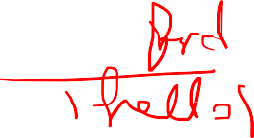


Suppose:
hello friend
𝟕
𝑷 𝒉𝒆𝒍𝒍𝒐 𝑵 =
hello friend win work
𝟏𝟖
𝟓
𝑷 𝒇𝒓𝒊𝒆𝒏𝒅 𝑵 =
𝟏𝟖
hello friend win prize
𝑷 𝒘𝒐𝒓𝒌 𝑵 =
𝑷 𝒑𝒓𝒊𝒛𝒆 𝑵 =
𝟏
𝟏𝟖
𝟑
𝟏𝟖
hello friend work hello
𝟐
𝑷 𝒘𝒊𝒏 𝑵 =
𝟏𝟖
hello friend hello work
hello
friend
prize work
win
𝑷 𝑵 𝒉𝒆𝒍𝒍𝒐 𝒇𝒓𝒊𝒆𝒏𝒅
= 𝑷 𝑵 ∗ 𝑷 𝒉𝒆𝒍𝒍𝒐 𝑵 ∗ 𝑷 𝒇𝒓𝒊𝒆𝒏𝒅 𝑵
𝑷 𝑵 𝒉𝒆𝒍𝒍𝒐 𝒇𝒓𝒊𝒆𝒏𝒅
= 𝑷 𝑵 ∗ 𝑷 𝒉𝒆𝒍𝒍𝒐 𝑵 ∗ 𝑷 𝒇𝒓𝒊𝒆𝒏𝒅 𝒉𝒆𝒍𝒍𝒐 𝑵
𝟓 𝟕 𝟓
𝟓 𝟕 𝒇𝒓𝒊𝒆𝒏𝒅 𝟓 𝟕 𝟓
= ∗ ∗ = 𝟎. 𝟎𝟔𝟕𝟓
= ∗ ∗ = ∗ ∗ = 𝟎. 𝟏𝟕
𝟖 𝟏𝟖 𝟏𝟖
𝟖 𝟏𝟖
𝒉𝒆𝒍𝒍𝒐
𝟖 𝟏𝟖 𝟕

Slide 53



Independence and Mutual Exclusion
A B
A B
Not Independent
𝑃(𝐴|𝐵) ≠ 𝐴
𝑃(𝐵|𝐴) ≠ 𝐵
Independent? / Mutually exclusive?
𝑃 𝐴 ∩ 𝐵 = 0
For independent events:
𝑃 𝐴 ∩ 𝐵 = 𝑃 𝐴 . 𝑃(𝐵)
𝑃 𝐴 ∩ 𝐵
𝑃 𝐴 ∩ 𝐵
𝑃 𝐴 ∩ 𝐵
= 𝑃 𝐴 . 𝑃(𝐵|𝐴)
= 𝑃 𝐵 . 𝑃(𝐴|𝐵)
≠ 𝑃 𝐴 . 𝑃(𝐵)
Mutually exclusive events A and B are independent if and only if
𝑃 𝐴 = 0 𝑜𝑟 𝑃 𝐵 = 0
Otherwise, A and B are not independent Also,
𝑃 𝐴 𝐵 = 0 ≠ 𝑃(𝐴), 𝑎𝑛𝑑 𝑃 𝐵 𝐴 = 0 ≠ 𝑃(𝐵)
For mutually exclusive events.
e.g. A=“Heads”, B=“Tails” for a coin
e.g. A=“6”, B=“5” on a die
Ref: Are mutually exclusive events independent? https://www.youtube.com/watch?v=UOfsad9WWwk

